Slide 1

Hands on Test
Wilmar Yair Sanchez
Bogota march 2020

Slide 2
Scope
-Provide a set of Automation test cases which apply to Hands on test’s User stories.

Slide 3
Resources
-the automation test cases were developed with the following components:
Eclipse – IDE
Java script language
Junit Test framework
Selenium Automate test framework.

Slide 4
functional test cases
First Test case:
Steps
Expect Results
Open or launch the web browser
Launch chrome browser
Type the URL “google.com” in the address bar
Google search web page open
Type “The name of the wind” in search box
Click on Google Search button
Go to search result page
Click on first result is “The Name of the Wind - Patrick Rothfuss”
Open first result Wikipedia.

Slide 5
functional test cases
Second Test case:
Steps
Expect Results
Open or launch the web browser
Launch chrome browser
Type the URL “google.com” in the address bar
Google search web page open
Type “The name of the w” in search box
click on the first suggestion
Go to search result page
Click on first result is “The Name of the Wind - Patrick Rothfuss”
Open first result Wikipedia.

Slide 6
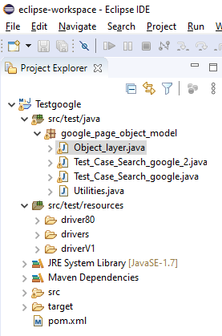
project structure
First Layer: wrappers and utilities
On this layer, all the method provide by selenium are wrapped. Therefore any change on selenium version will not affect the test cases
Second Layer: element, object, and behaviors
On this layer, the objects and the action that you can do with them are identified and they are available for any test cases
Third Layer: automated test cases
On this layer, you can find any step required to execute the automated test cases.

Slide 7
Approach to POM pattern
the page object model suggest to hands on test problem was:
First Layer: wrappers and utilities
On this layer, all the method provide by selenium are wrapped. Therefore any change on selenium version will not affect the test cases
Second Layer: element, object, and behaviors
On this layer, the objects and the action that you can do with them are identified and they are available for any test cases
Third Layer: automated test cases
On this layer, you can find any step required to execute the automated test cases.

Slide 8
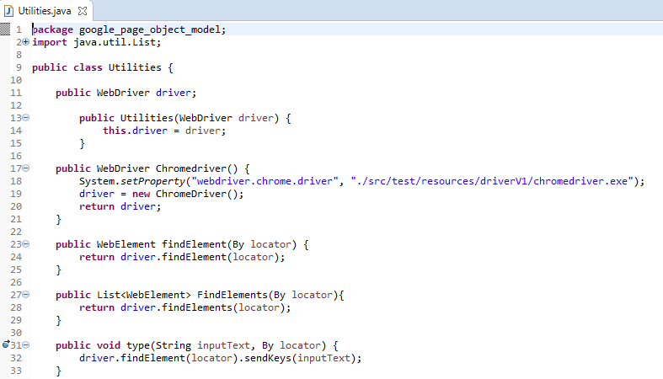
Approach to POM pattern
First Layer: wrappers and utilities
Methods
Wrappers

Slide 9
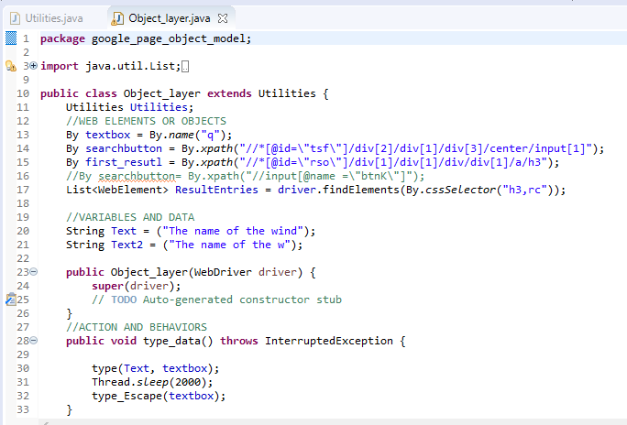
Approach to POM pattern
Second Layer: element, object, and behaviors
Main page objects
Page object actions and functions

Slide 10
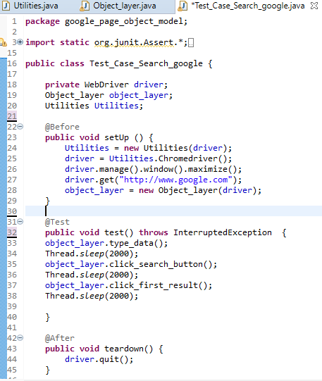
Approach to POM pattern
Third Layer: automated test cases
Before requirements
Test
Test cases steps
After requirements

Slide 11
Object oriented programming
-the current project achieves the Object Oriented Programming characteristics:
Abstraction: most required behaviors are cover in Second Layer: element, object, and behaviors.
Polymorphism: behavior’s object can be shared and called on Third Layer: automated test cases.
Encapsulation: it’s presented in any class created by all layers.
Inheritance: any class method can be used by any given class.

Slide 12


